Slide 1
Java Control Structures Part 2
Chapter 5

Slide 2
The while statement
The basic format of the while statement
while (expression)
statement

Slide 3
The while statement begins by evaluating the expression. If the expression is true, statement is executed. Then the expression is evaluated again, and the whole process repeats. If the expression is false, statement is not executed, and the while loop ends.

Slide 4
Example of a typical while loop:
public class EvenCounter{
public static void main (String[] args) {
int number = 2;
while (number <= 20) {
System.out.print(number + " "); number += 2;
}
System.out.println();
}}

Slide 5
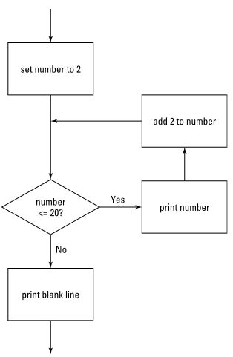
5-1 shows a flowchart for this program. This flowchart can help you visualize the basic decision-making process of a loop.

Slide 6
Breaking Out of a Loop
In many programs, you need to set up a loop that has some kind of escape clause. Java’s escape clause is the break statement. When a break statement is executed in a while loop, the loop ends immediately. Any remaining statements in the loop are ignored, and the next statement executed is the statement that follows the loop.

Slide 7
Example
public class Dodecaphobia{
public static void main(String[] args) {
int number = 2;
while (number <= 20) {
if (number == 12)
break;
System.out.print(number + " ");
number += 2;
}
System.out.println();
}}

Slide 8
Infinite Looping
One common form of loop is called an infinite loop. That is a loop that goes on forever. You can create infinite loops many ways in Java (not all of them intentional), but the easiest is to just specify true for the while expression.

Slide 9
Example
public class CountForever{
public static void main(String[] args) {
int number = 2;
while (true) {
System.out.print(number + " ");
number += 2;
}
}
}

Slide 10
Obviously, infinite loops are something you want to avoid in your programs. So whenever you use a while expression that’s always true, be sure to throw in a break statement to give your loop some way to terminate. You could use an infinite loop with a break statement in the Dodecaphobia program.

Slide 11
Letting the user decide when to quit
It turns out that infinite loops are also useful when you want to let the user be in charge of when to stop the loop. Suppose that you do not know what numbers a user is afraid of, so you want to count numbers until the user says to stop.

Slide 12
Example
import java.util.Scanner;
public class NumberPhobia {
static Scanner sc = new Scanner(System.in);
public static void main(String[] args){
int number = 2;
String input;
while (true) {
System.out.println(number + " ");
System.out.print ("Do you want to keep counting?" + " (Y or N)"); input = sc.next();
if (input.equalsIgnoreCase("N"))
break;
number+= 2;
}
System.out.println("\nWhew! That was close.\n");
}}

Slide 13
Letting the user decide in another way
Another way to write a loop that a user can opt out of is to test the input string in the while condition. The only trick here is that you must first initialize the input string to the value that continues the loop. Otherwise, the loop does not execute at all!

Slide 14
Example
import java.util.Scanner;
public class NumberPhobia2{
static Scanner sc = new Scanner(System.in);
public static void main(String[] args) {
int number = 2;
String input = "Y";
while (input.equalsIgnoreCase("Y")) {
System.out.println(number + " ");
System.out.print ("Do you want to keep counting?" + " (Y or N)");
input = sc.next();
number += 2;
}
System.out.println("\nWhew! That was close.");
}
}

Slide 15
Using the continue Statement
The break statement is rather harsh: It completely bails out of the loop. Sometimes that is what you need — but just as often, you do not really need to quit the loop; you just need to skip a particular iteration of the loop

Slide 16
The “continue” statement sends control right back to the top of the loop, where the expression is immediately evaluated again. If the expression is still true, the loop’s statement or block is executed again.

Slide 17
Example
public class Dodecaphobia3{
public static void main(String[] args) {
int number = 0;
while (number < 20) {
number += 2;
if (number == 12)
continue;
System.out.print(number + " ");
}
System.out.println();
}
}

Slide 18
do-while Loops
A do-while loop (sometimes just called a do loop) is similar to a while loop, but with a critical difference: In a do-while loop, the condition that stops the loop isn’t tested until after the statements in the loop have executed. The basic form of a do-while loop is this:
do
Statement
while (expression);

Slide 19
Example
public class EvenCounter2{
public static void main(String[] args) {
int number = 2;
do {
System.out.print(number + " ");
number += 2;
} while (number <= 20);
System.out.println();
}}

Slide 20
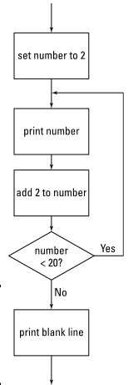
Figure 5-2: The flowchart for a do-while loop.

Slide 21
The For Loop
The basic principle behind a for loop is that the loop itself maintains a counter variable — that is, a variable whose value increases each time the body of the loop is executed. If you want a loop that counts from 1 to 10, you’d use a counter variable that starts with a value of 1 and is increased by 1 each time through the loop.

Slide 22
Format of the for loop
for (initialization-expression; test-expression; count-expression) statement;
The three expressions in the parentheses following the keyword for control how the for loop works

Slide 23
The initialization expression is executed before the loop begins. Usually, you use this expression to initialize the counter variable. If you have not declared the counter variable before the for statement, you can declare it here too.

Slide 24
The test expression is evaluated each time the loop is executed to determine whether the loop should keep looping. Usually, this expression tests the counter variable to make sure that it is still less than or equal to the value you want to count to.

Slide 25
The loop keeps executing as long as this expression evaluates to true. When the test expression evaluates to false, the loop ends.

Slide 26
The count expression is evaluated each time the loop executes. Its job is usually to increment the counter variable.

Slide 27
Here’s a simple for loop that displays the numbers 1 to 10 on the console:
public class CountToTen{
public static void main(String[] args) {
for (int i = 1; i <= 10; i++)
System.out.println(i);
}
}

Slide 28
Nested Loops
Loops can contain loops. The technical term for this is loop-de-loop. Just kid-ding. Actually, the technical term is nested loop, which is simply a loop that is completely contained inside another loop. The loop that’s inside is called the inner loop, and the loop that’s outside is called the outer loop.

Slide 29
A simple nested for loop
public class NestedLoop{
public static void main(String[] args) {
for(int x = 1; x < 10; x++) {
for (int y = 1; y < 10; y++)
System.out.print(x + "-" + y + " ");
System.out.println();
}
}
}

Slide 30
True or False
The while statement begins by evaluating the expression. If the expression is true, statement is executed. Then the expression is evaluated again, and the whole process repeats.

Slide 31
True or False
When a break statement is executed in a while loop, the loop ends immediately.

Slide 32
True or False
An infinite loop is a loop that repeats indefinitely until the user decides to stop it

Slide 33
True or False
The “continue” statement sends control right back to the top of the loop, where the expression is immediately evaluated again.

Slide 34
True or False
do-while is the only looping statement that executes at least once even if the condition evaluation is already false from the start.

Slide 35
Congratulations !!!! we can now move forward to the next topic

